Slide 1

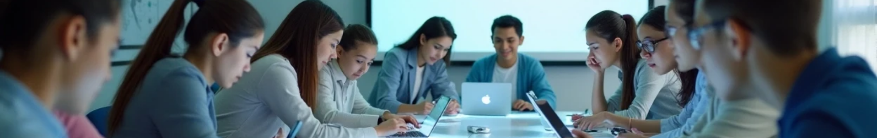
AI Tutor Pitch Presentation

Slide 2

CONTENTS
1. Title Slide
2. Problem Statement
3. Proposed Solution
4. Key Features
5. How It Works
6. User Benefits
7. Target Audience
8. Future Scope
9. Team Introduction
10. Thank You Slide

Slide 3

01
Title Slide

Slide 4
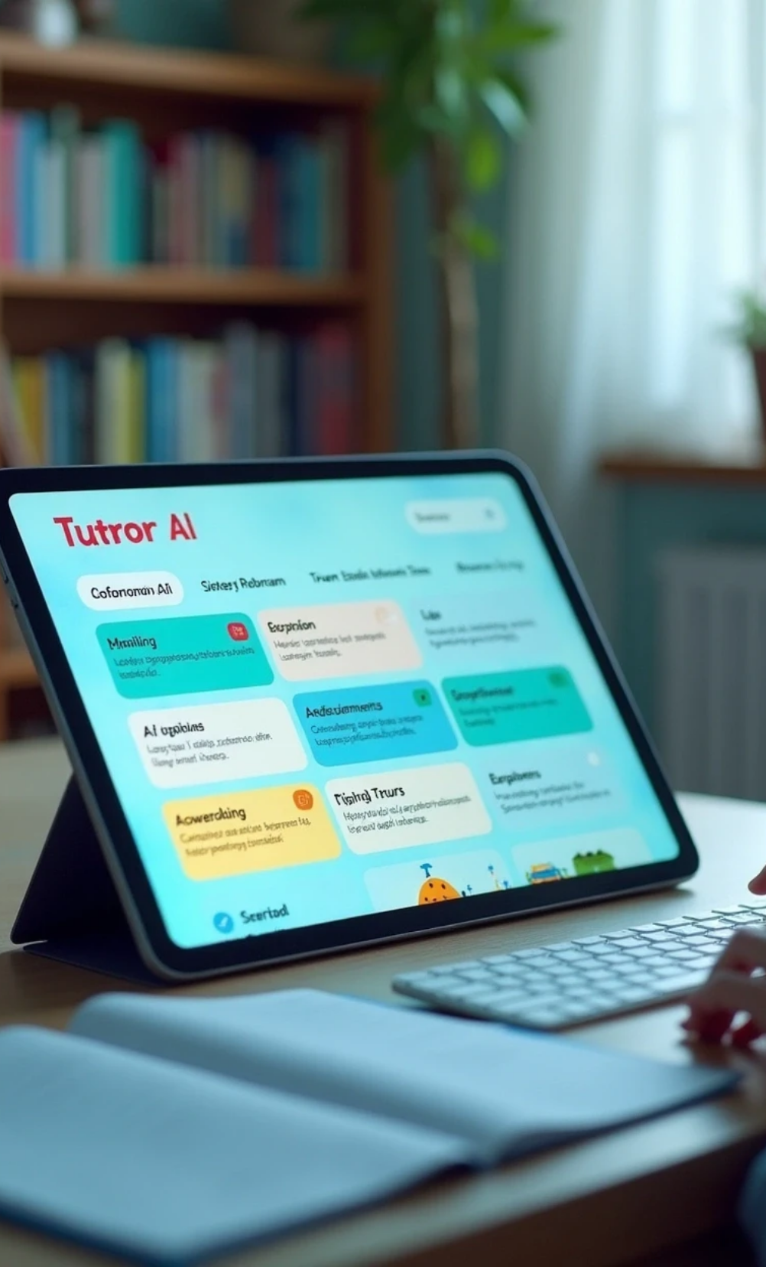


Title Slide
App Name
Tagline
AI Tutor
Explaining concepts in three ways – Text, Visual Image, and Analogy
Team Name
Team Members
AIVORA
• Megaranjini S
• Iniya R

Slide 5

02
Problem Statement

Slide 6
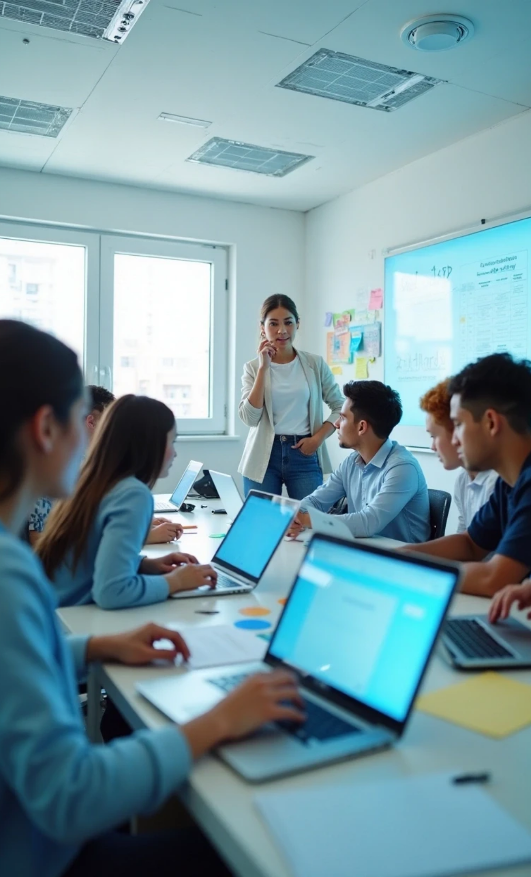
Problem Statement
Students often face difficulties in understanding complex topics. This can lead to confusion and hinder their learning process.

Slide 7

03
Proposed Solution

Slide 8
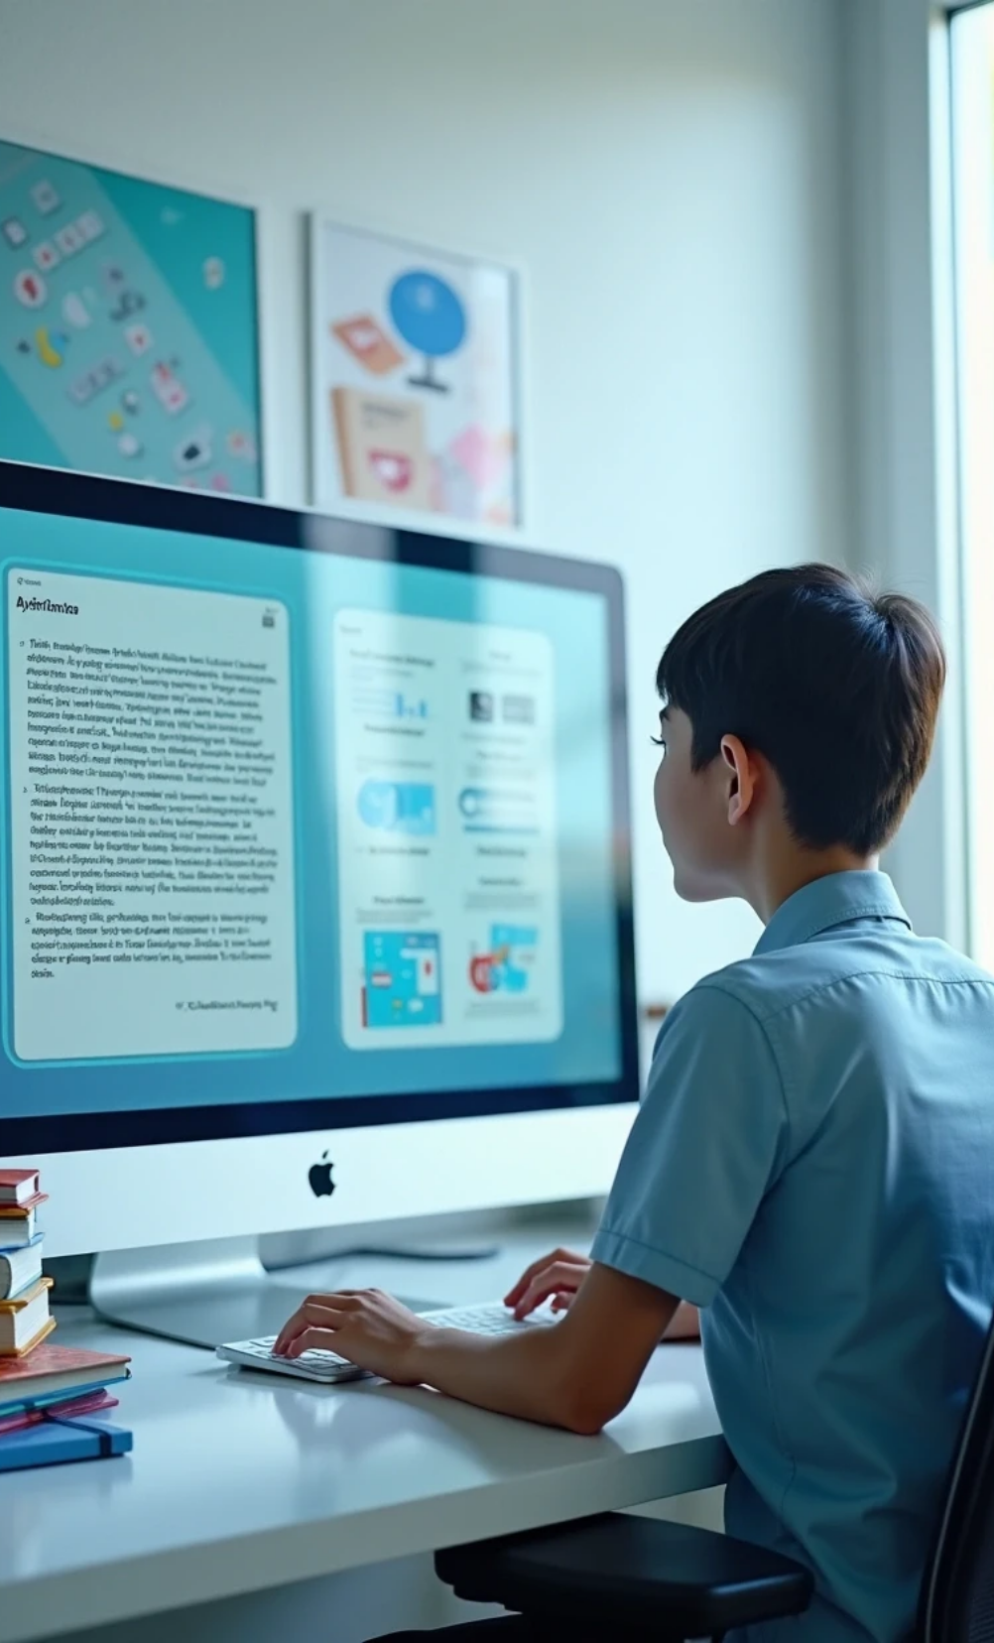

Proposed Solution
AI Tutor provides explanations using three distinct modes:
Text
Detailed and clear written explanations.
Visual Image
Illustrative images that aid comprehension.
Analogy
Relatable analogies that simplify hard concepts.

Slide 9

04
Key Features

Slide 10


Key Features
Clear explanations
Diagram support
Relatable analogies
Every concept is explained in simple terms.
Relevant diagrams accompany the text for better understanding.
Analogies provided to relate complex topics to everyday experiences.

Slide 11

05
How It Works

Slide 12
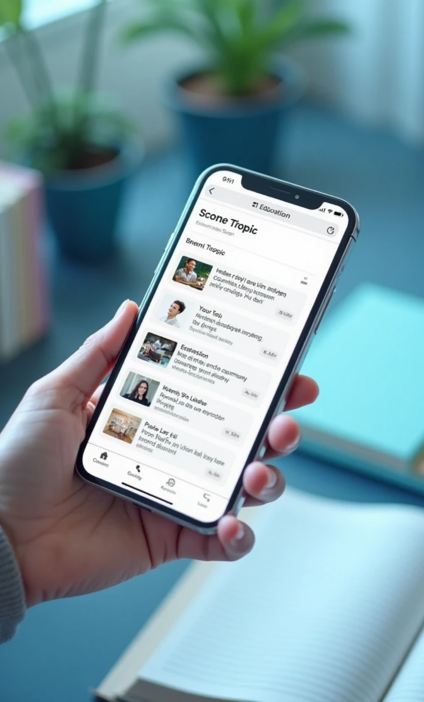


How It Works
Step-by-step flow of how the app delivers explanations:
User selects a topic.
The app provides a text explanation.
Visual images related to the topic are displayed.
Analogies are provided to reinforce understanding.

Slide 13

06
User Benefits

Slide 14
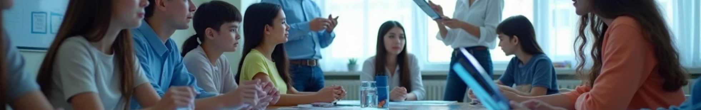

User Benefits
Simplified learning: Makes complicated topics easy to grasp.
Better understanding: Helps students retain information effectively.
Interactive support: Engages users with varied approaches.

Slide 15

07
Target Audience

Slide 16

Target Audience
Students
High school and college students seeking to understand complex subjects.
Teachers
Educators looking for additional resources for their students.
Lifelong learners
Individuals wanting to expand their knowledge in various fields.

Slide 17

08
Future Scope

Slide 18
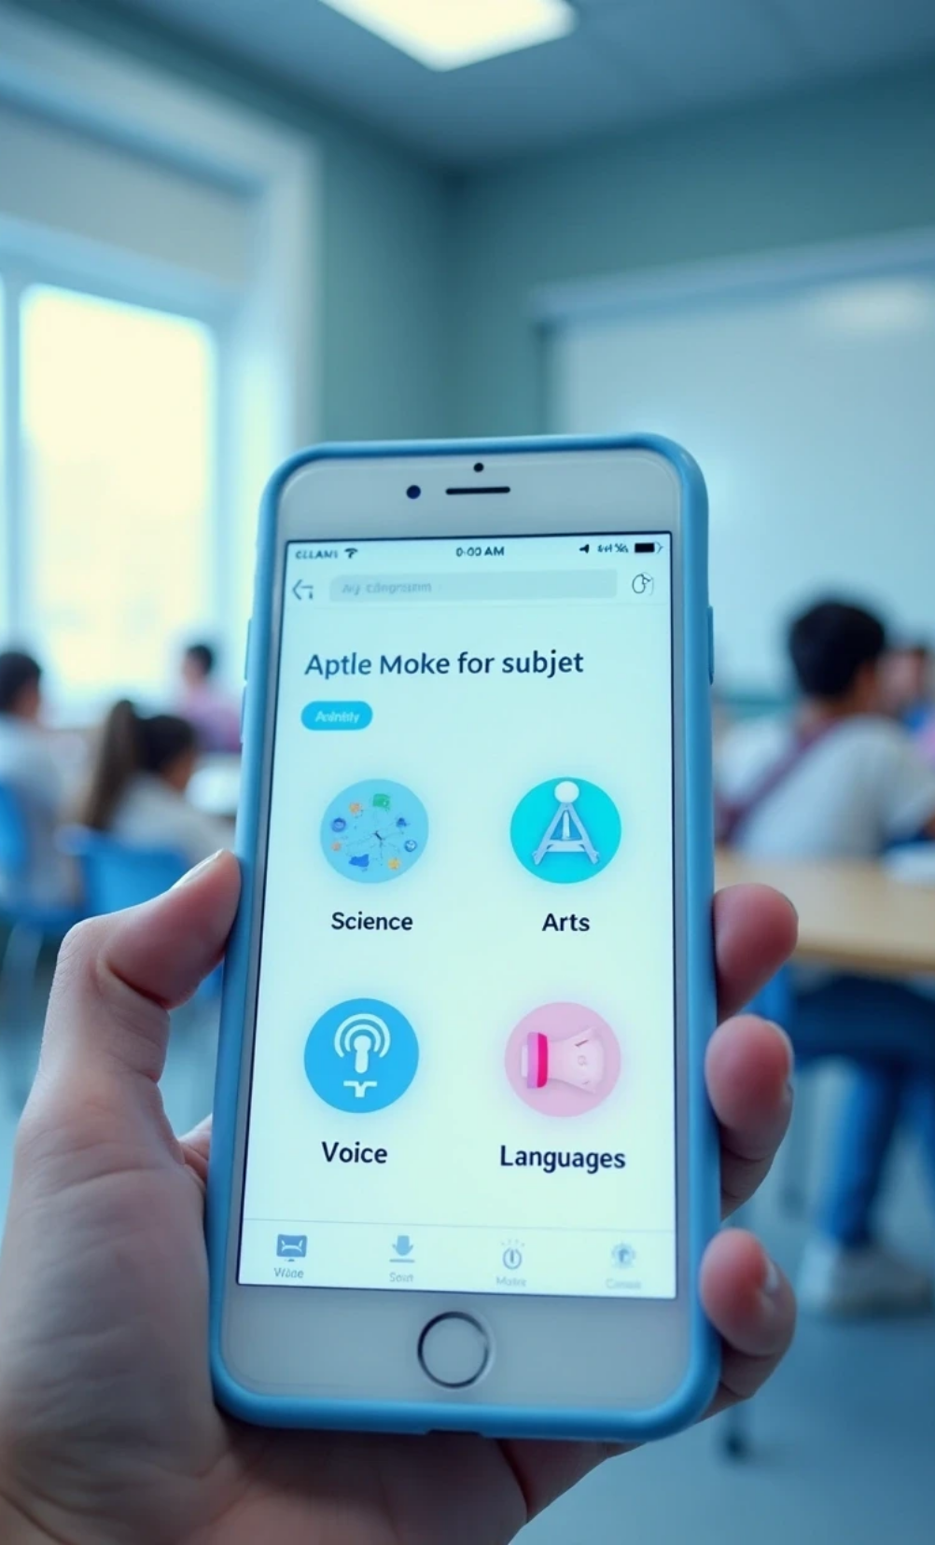
Future Scope
Adding more subjects: Expanding the app’s content to cover a wider range of topics.
Voice explanations: Implementing auditory support for users who prefer listening.
Multilingual support: Providing explanations in multiple languages to reach a broader audience.

Slide 19
09
Team Introduction

Slide 20



Team Introduction
Team Name
AIVORA
Team Members
• Megaranjini S
• Iniya R

Slide 21
10
Thank You Slide

Slide 22


Thank You Slide
Team Name
Contact Information
AIVORA
• megaranjinis.it24@bitsathy.ac.in
• inyar.ad24@bitsathy.ac.in

Slide 23
Thank You

